Slide 1
Automatic Hand Sanitizer Dispenser and Thermometer
SENSORS & INSTRUMENTATION
FINAL PROJECT
Trần Thanh Trúc – EEEEIU18099
Instructor: Dr. Huynh, Tan Quoc

Slide 2
CONTENT
Motivation
Components
Circuit Schematic
Flowchart
Demonstration

Slide 3

MOTIVATION

Slide 4
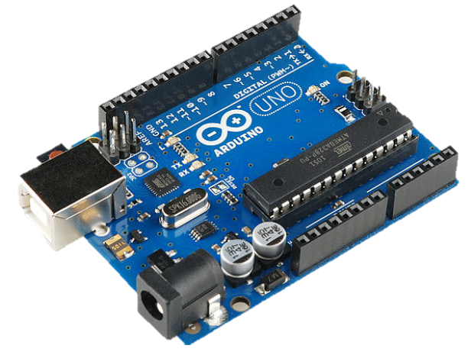
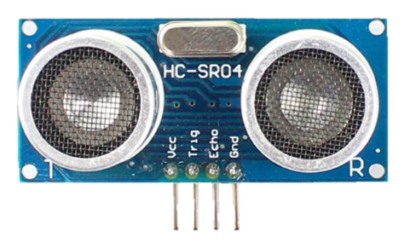
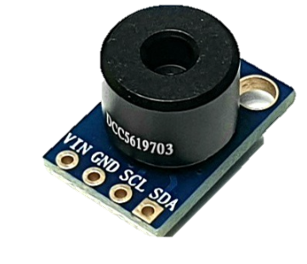
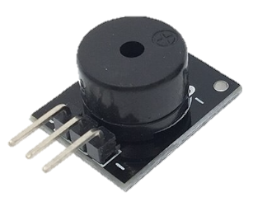
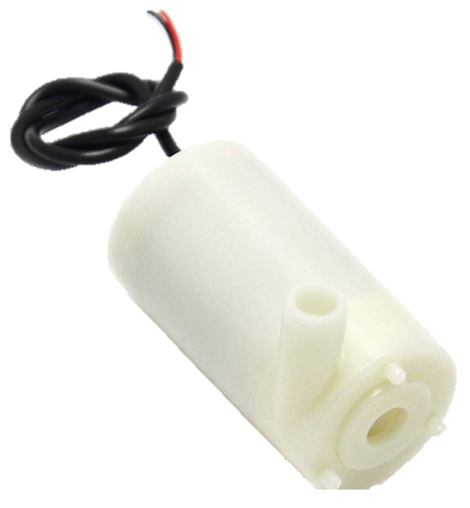
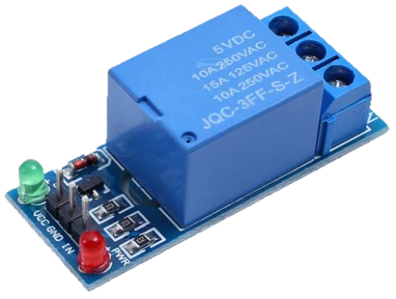
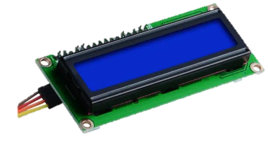
COMPONENTS
Arduino Uno R3
Ultrasonic Sensor HC-SR04
IR Temperature Sensor MLX90614
Passive Buzzer
Relay
Mini Pump Motor
16x2 I2C LCD

Slide 5
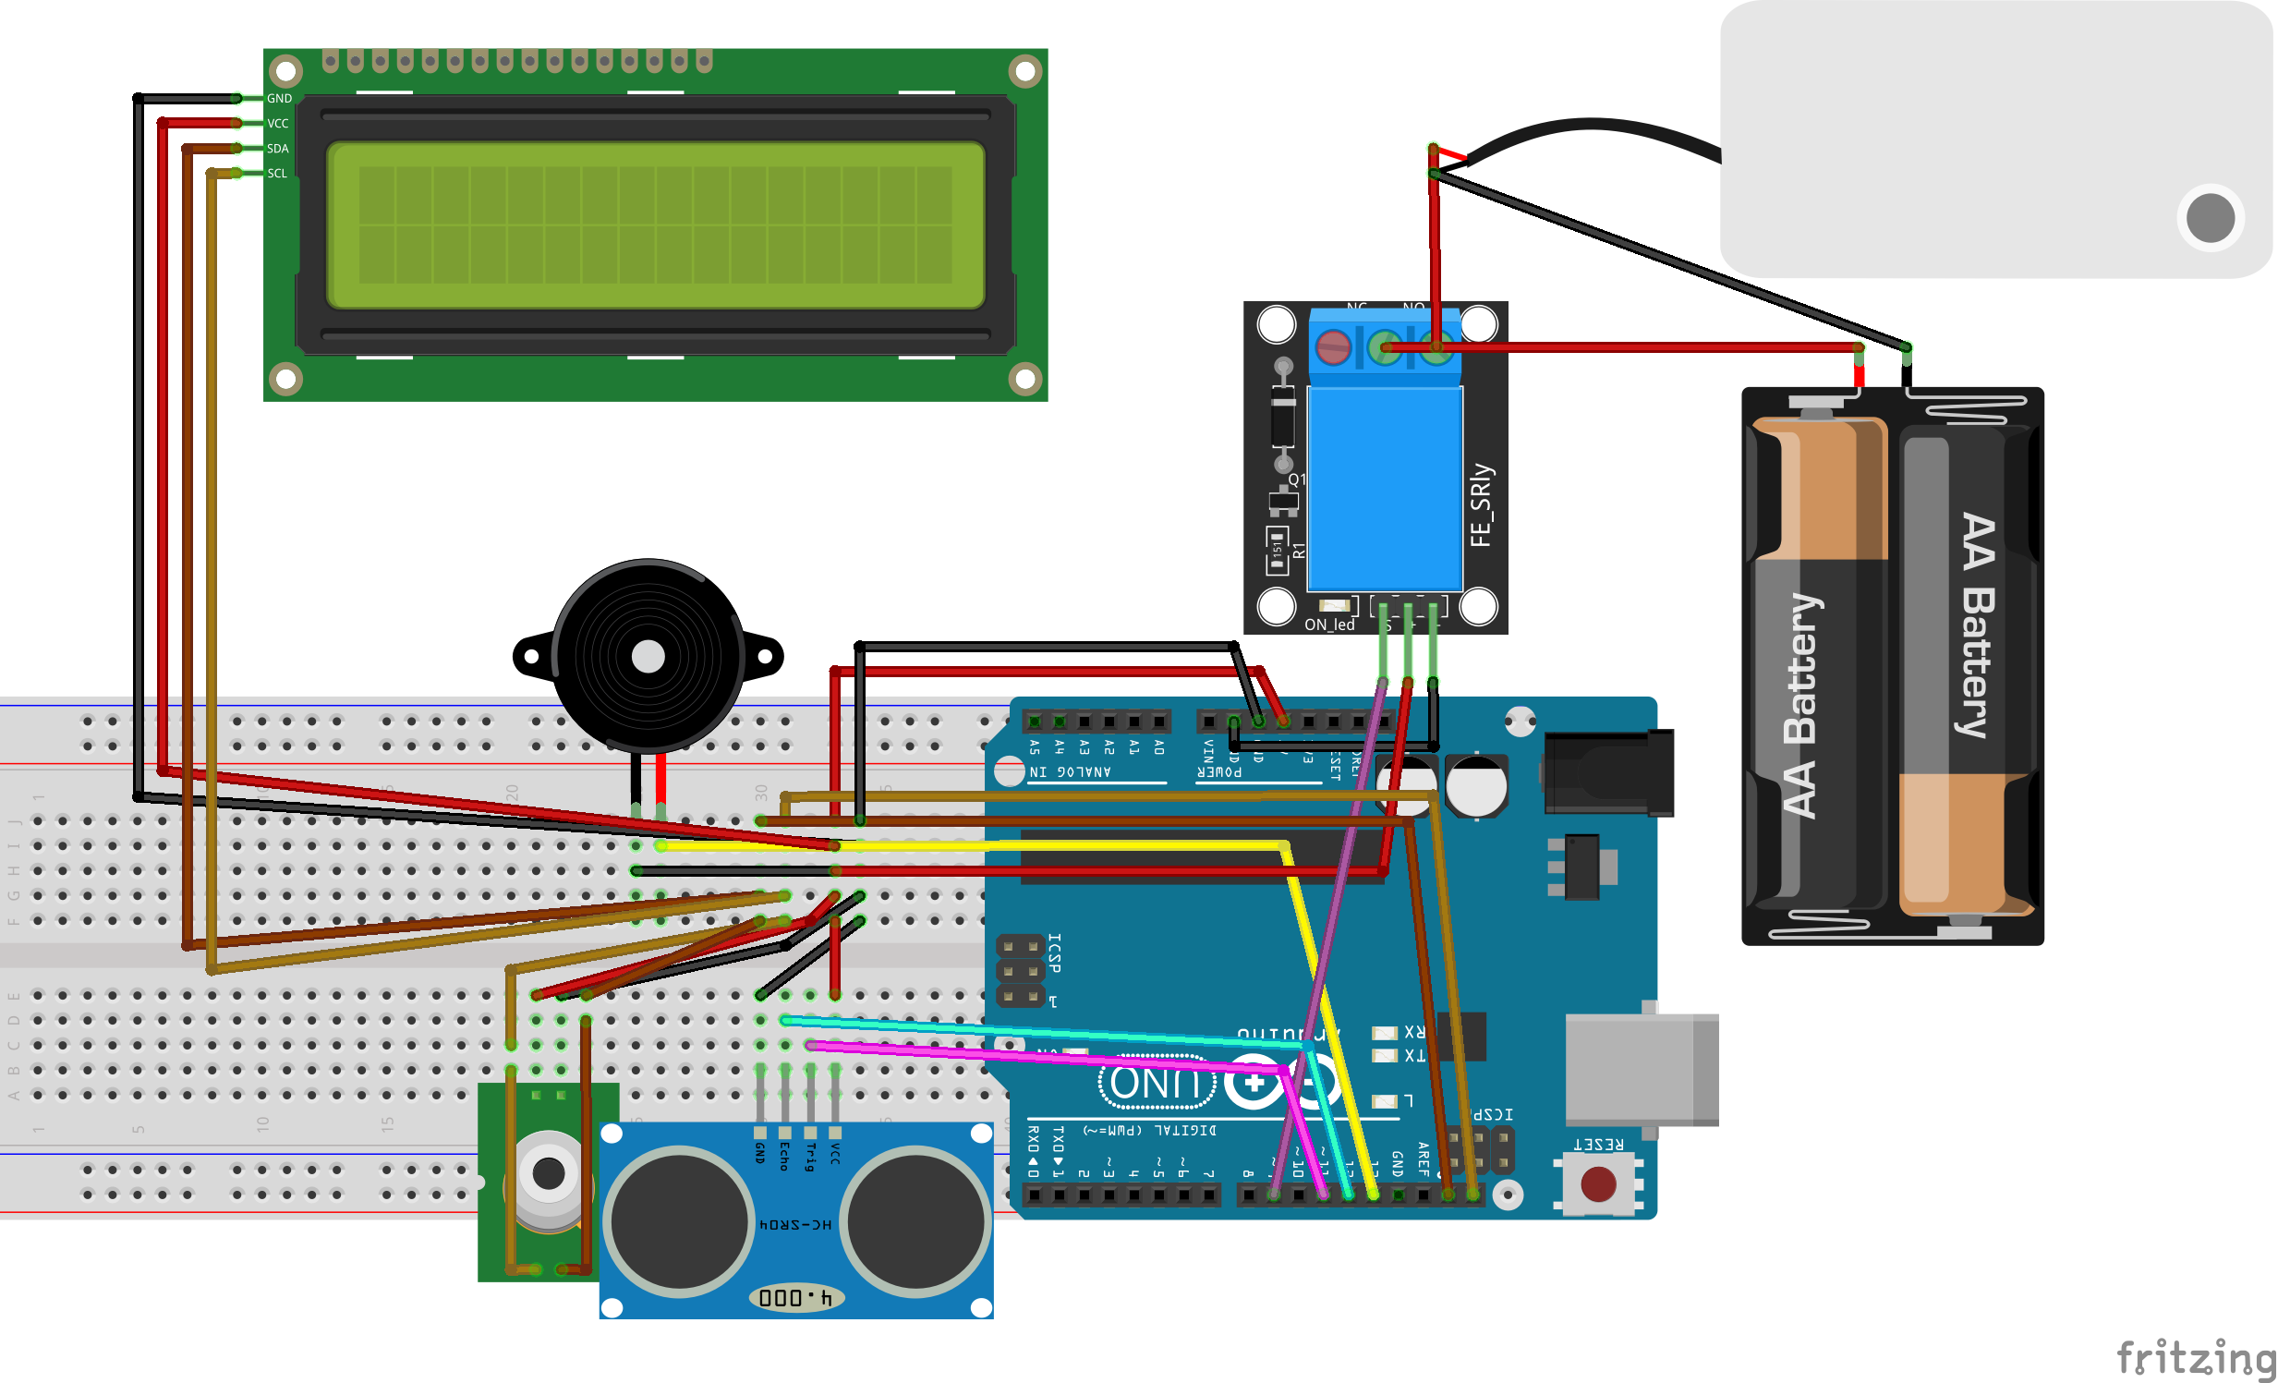
CIRCUIT SCHEMATIC

Slide 6
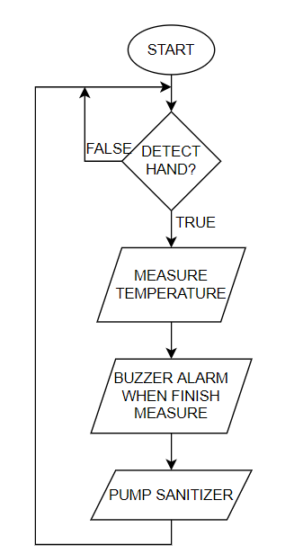
FLOWCHART

Slide 7
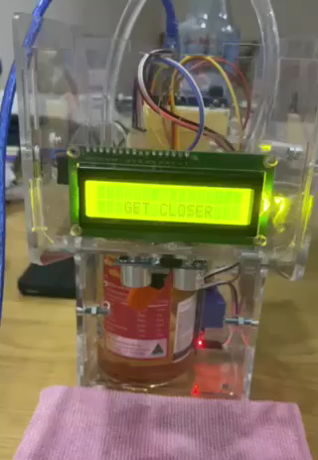
DEMONSTRATION

Slide 8
THANK YOU FOR LISTENING!
THE END

